Slide 1

Crafting an Automated Door Control System

Slide 2

LIST OF COMPONENTS:
ESP32 MICROCONTROLLER
SERVO MOTOR(SG90)
ULTRASONIC SENSOR(HC-SR04)
JUMPER WIRES
BREAD BOARD

Slide 3
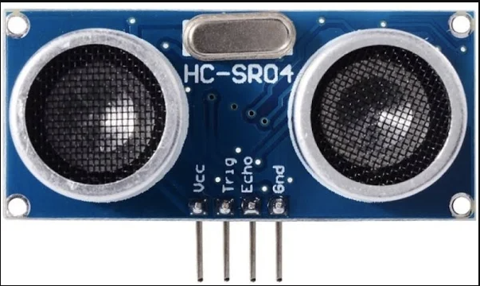
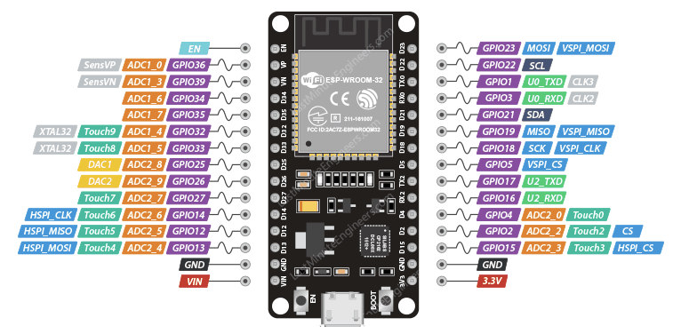
CIRCUIT DAIGRAM:
CONNECT TRIG PIN-D5

Slide 4
CONNECT ECHO PIN -D18

Slide 5
CONNECT VCC-3.3V

Slide 6
CONNECT GND-GND

Slide 7
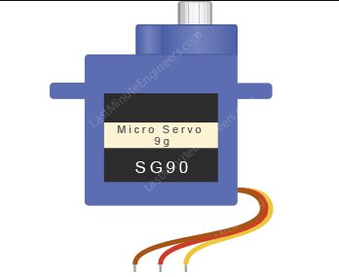
CONNECT RED WIRE-VIN

Slide 8
CONNECT BLACK WIRE-GND

Slide 9
CONNECT YELLOW WIRE-D13

Slide 10
CODE:
CONTINUE
#include <ESP32Servo.h>
Servo myservo;
const int trigPin = 5;
const int echoPin = 18;
const int servoPin = 13;
const int doorOpenAngle = 90;
const int doorCloseAngle = 0;
const int distanceThreshold = 30;
void setup() {
myservo.attach(servoPin);
pinMode(trigPin, OUTPUT);
pinMode(echoPin, INPUT);
Serial.begin(115200);
}
void loop() {
long duration, distance;
digitalWrite(trigPin, LOW);
delayMicroseconds(2);
digitalWrite(trigPin, HIGH);
delayMicroseconds(10);
digitalWrite(trigPin, LOW);
duration = pulseIn(echoPin, HIGH);
distance = duration * 0.034 / 2;
Serial.print("Distance: ");
Serial.print(distance);
Serial.println(" cm");
if (distance <= distanceThreshold) {
Serial.println("Obstacle detected, opening door!");
myservo.write(doorOpenAngle);
} else {
Serial.println("No obstacle, closing door!");
myservo.write(doorCloseAngle);
}
delay(1000);
}

Slide 11
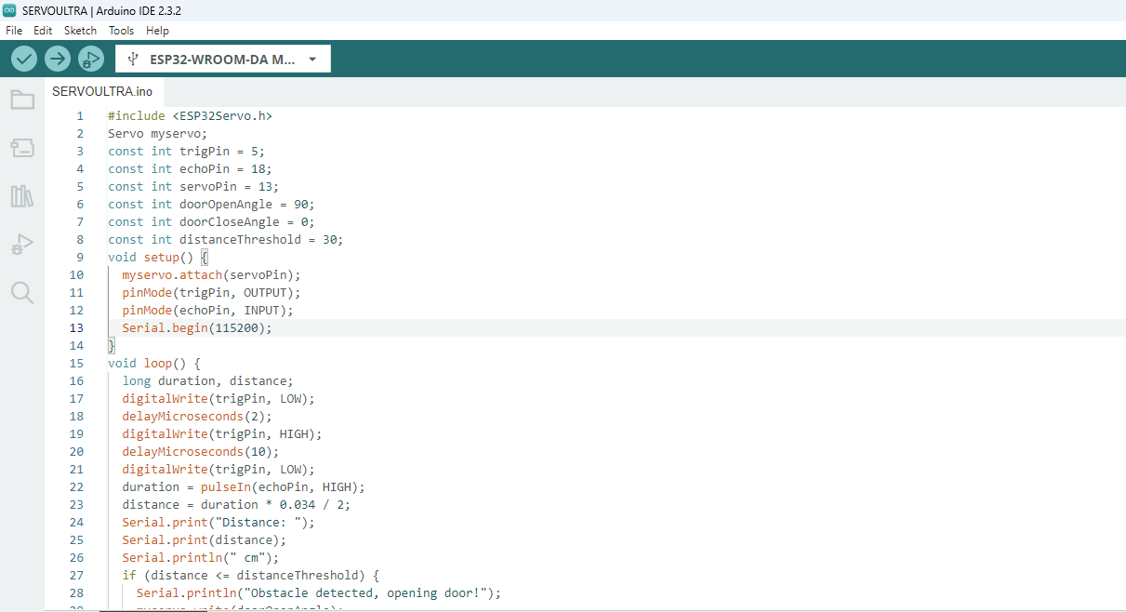
STEP 1
Copy code paste in Arduino new Sketch

Slide 12
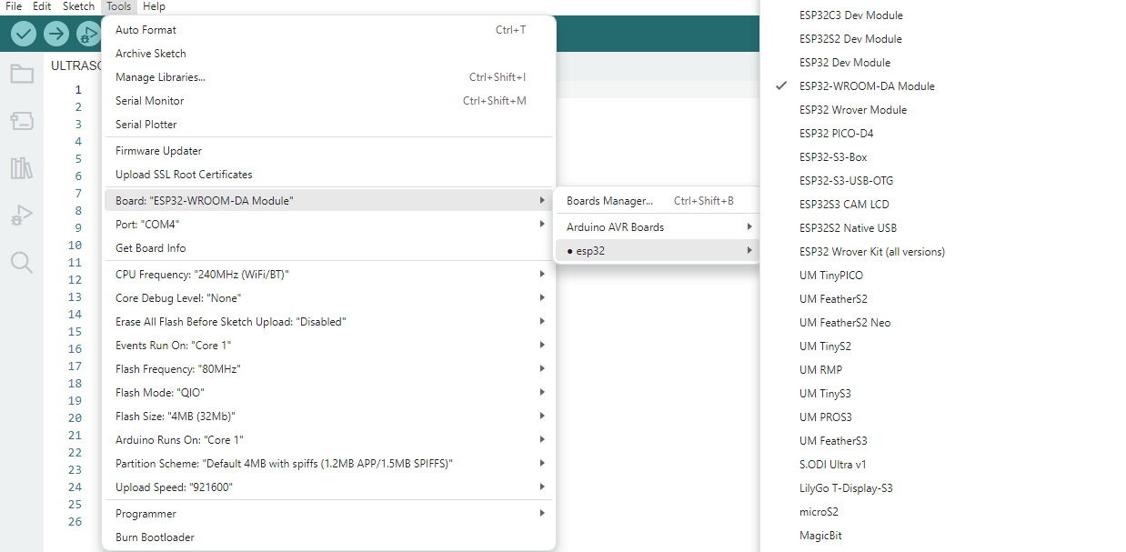
STEP 2
Board---->esp32---->esp32-wroom-DA module

Slide 13
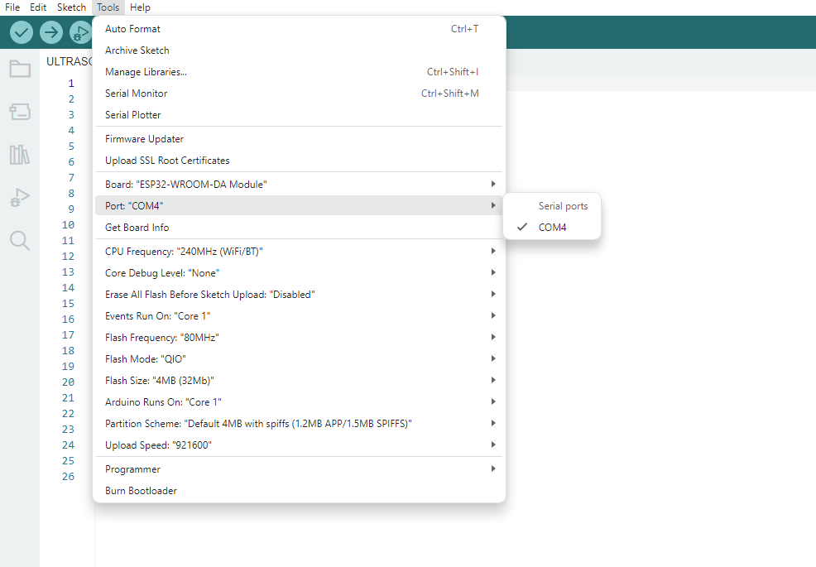
STEP 3
Tools---->port---->select your com

Slide 14
board name automatically change to dark

Slide 15
2.After Compilation build the code to board
1.Compile the code

Slide 16
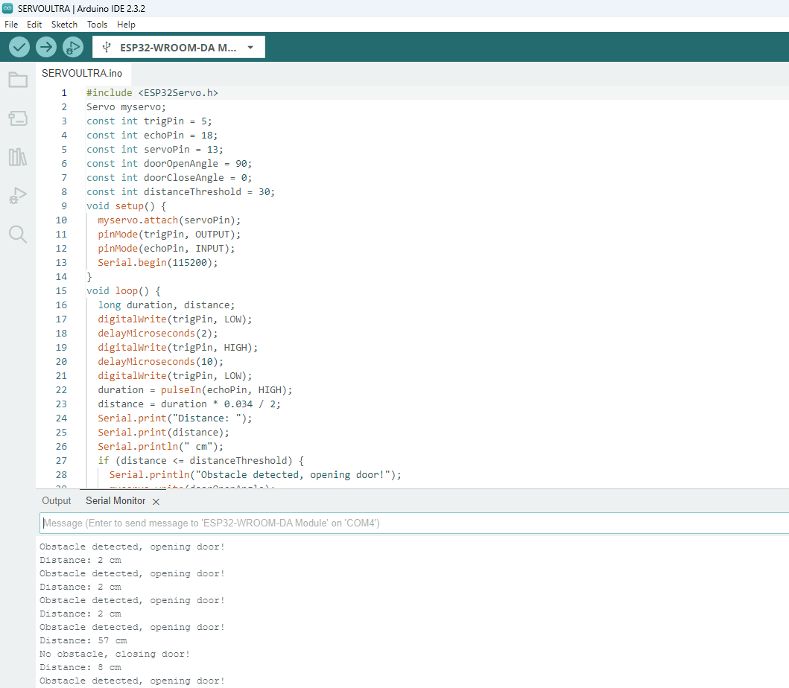
After Build the code the output like this

